Slide 1

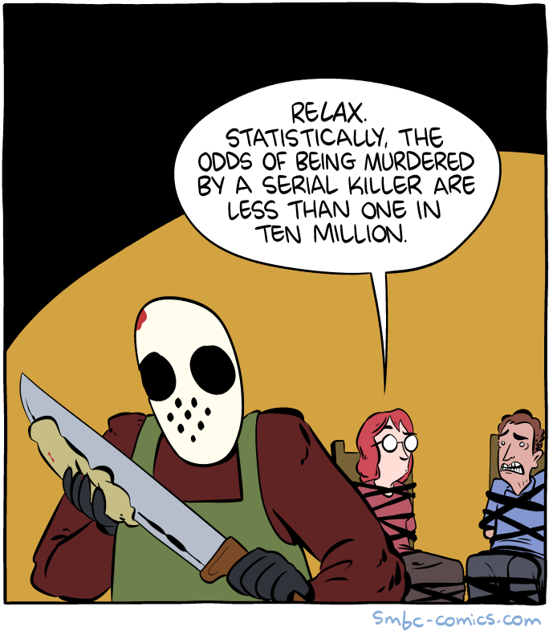
ANLY 6100: Data Analytics I Quick Probability Recap
Fall 2020, Topic 0.5
Professor: Courtney Paulson
Image description: Two people are tied to chairs as a man with a mask is sharpening a large knife. One person says, “Relax. Statistically the odds of being murdered by a serial killer are less than one in ten million.”

Slide 2
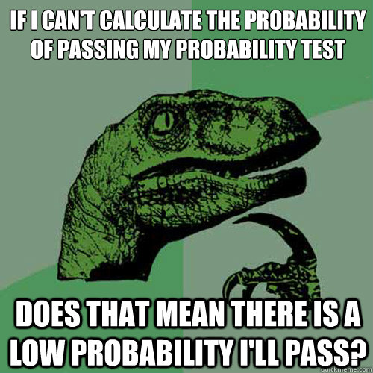
What is a Probability?
You’ve all taken stats before! What actually is the definition of a probability?
Image description: Philosoraptor meme with text: “If I can’t calculate the probability of passing my probability test, does that mean there is a low probability I’ll pass?”
Source: http://www.quickmeme.com/meme/362w7k

Slide 3
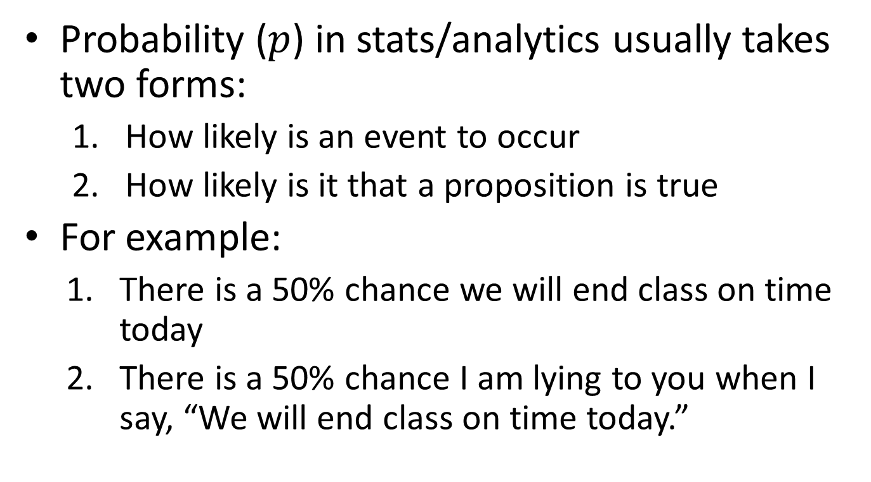
Probability and Odds
Probability ($p$) in stats/analytics usually takes two forms:
How likely is an event to occur
How likely is it that a proposition is true
For example:
There is a 50% chance we will end class on time today
There is a 50% chance I am lying to you when I say, “We will end class on time today.”

Slide 4
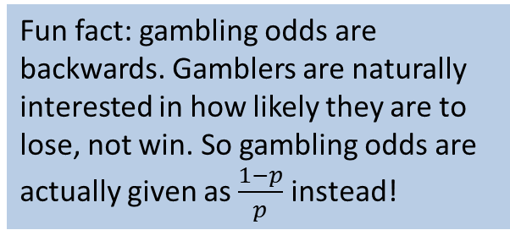
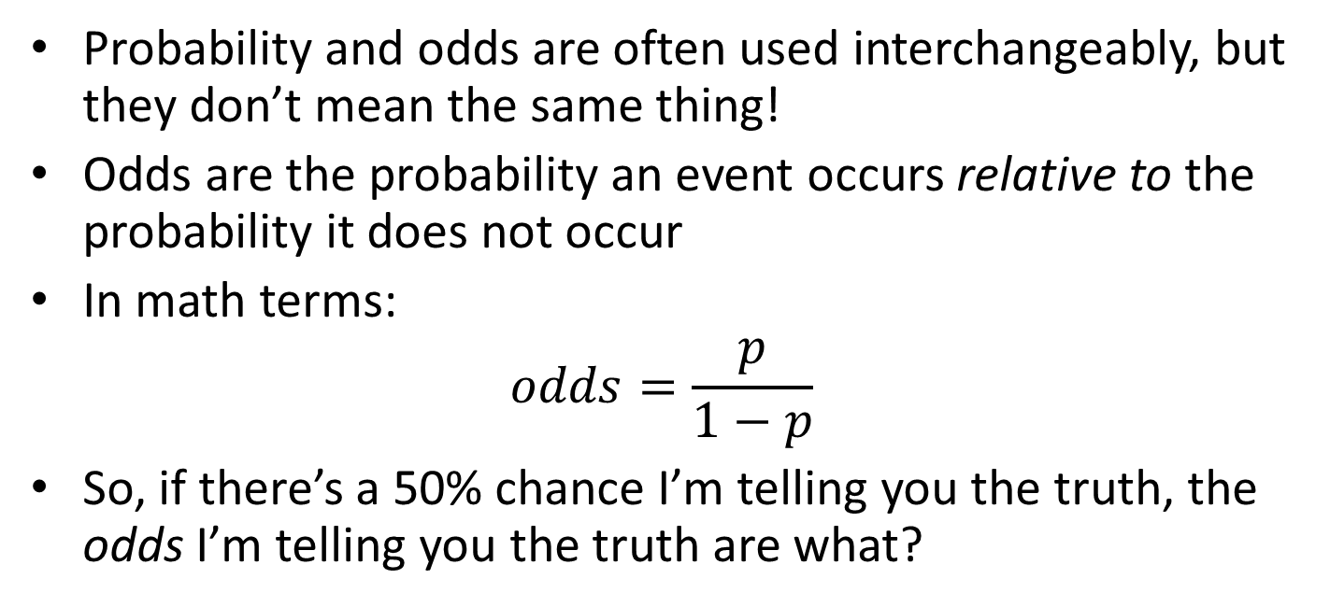
Probability and Odds
Probability and odds are often used interchangeably, but they don’t mean the same thing!
Odds are the probability an event occurs relative to the probability it does not occur
In math terms:
$$odds=\frac{p}{1−p}$$
So, if there’s a 50% chance I’m telling you the truth, the odds I’m telling you the truth are what?
Fun fact: gambling odds are backwards. Gamblers are naturally interested in how likely they are to lose, not win. So gambling odds are actually given as $\frac{1−p}{p}$ instead!

Slide 5
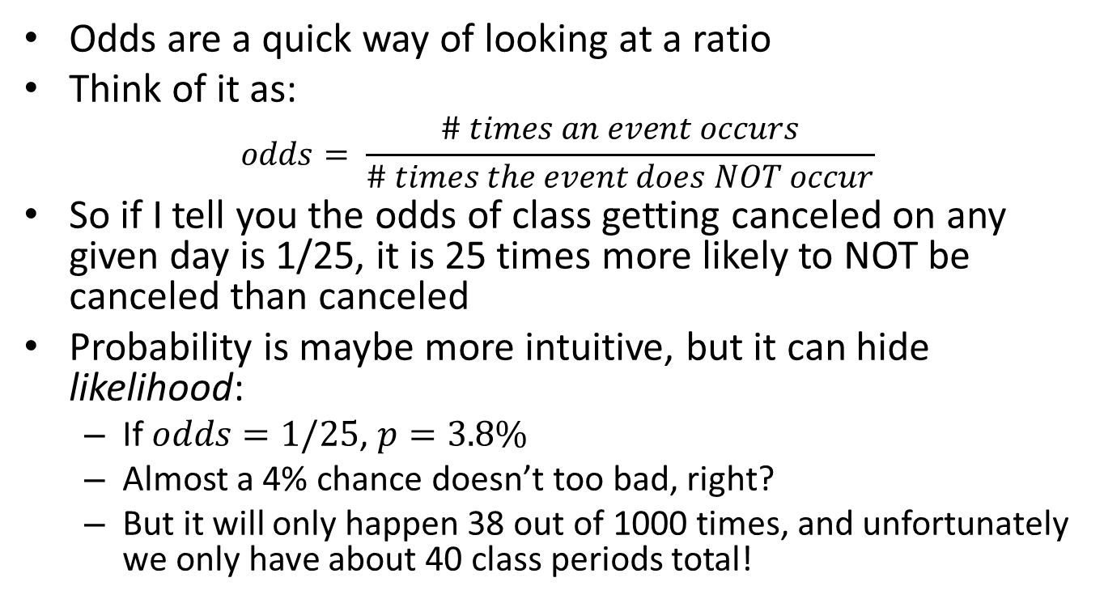
Why do we have both?
Odds are a quick way of looking at a ratio
Think of it as:
$$odds= \frac{\# times an event occurs}{\# times the event does NOT occur}$$
So if I tell you the odds of class getting canceled on any given day is 1/25, it is 25 times more likely to NOT be canceled than canceled
Probability is maybe more intuitive, but it can hide likelihood:
If $odds=1/25$, $p=3.8\%$
Almost a 4% chance doesn’t too bad, right?
But it will only happen 38 out of 1000 times, and unfortunately we only have about 40 class periods total!

Slide 6
What’s this got to do with analytics?
Data analytics is 100% probability (though we’ll say 99% to be safe!)
You are trying to determine how likely something is to happen or be true
Or perhaps related: What is the most likely outcome from a set of outcomes?
Facebook logo: Which unconnected users are likely to be friends?
Netflix logo: How many stars will the user most likely give this movie?
Amazon logo: What products will a user purchase given they bought a PS4?
Bank of America logo: What is the probability this account is fraudulent?
Comedy Central logo: What percentage of 11:00 PM cable viewers will watch The Daily Show?
Pittsburgh Pirates logo: Which rookie player is going to be the best investment for my team?

Slide 7
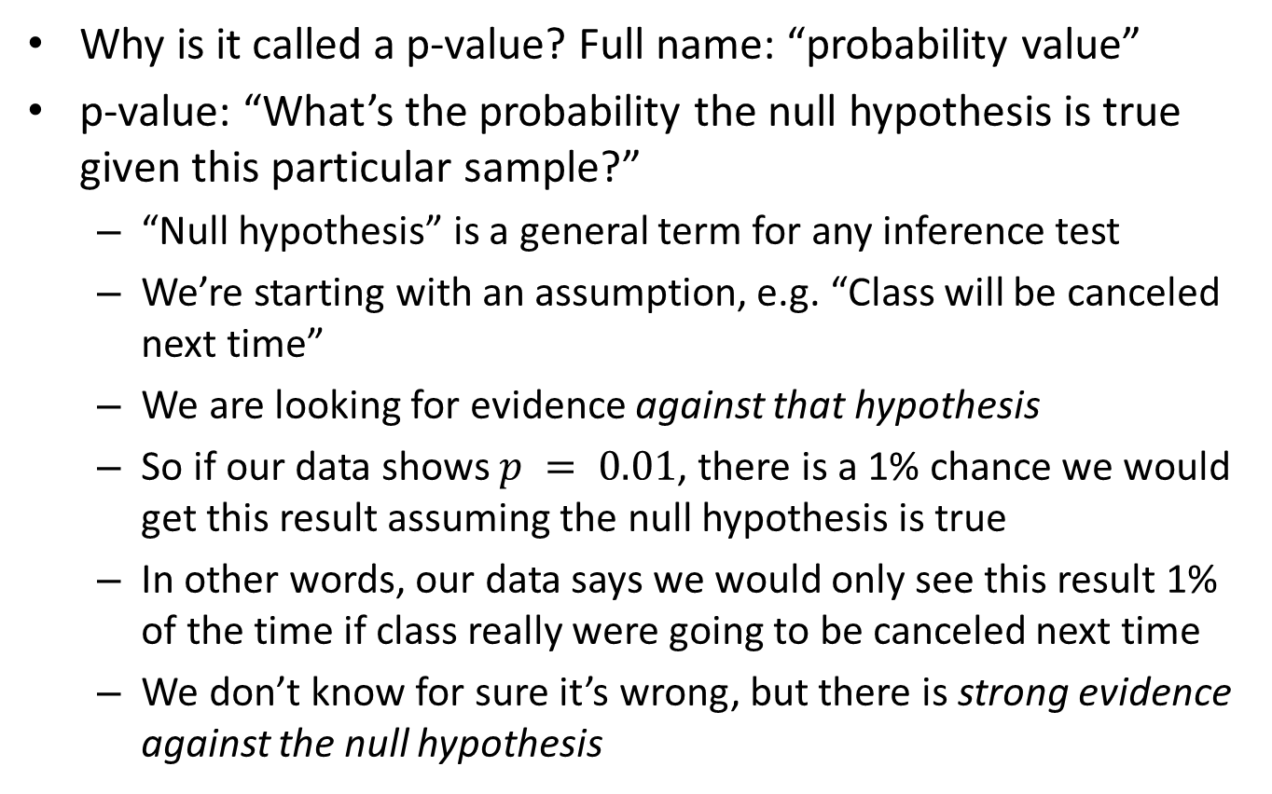
You’ve heard of a p-value before, right…?
Why is it called a p-value? Full name: “probability value”
p-value: “What’s the probability the null hypothesis is true given this particular sample?”
“Null hypothesis” is a general term for any inference test
We’re starting with an assumption, e.g. “Class will be canceled next time”
We are looking for evidence against that hypothesis
So if our data shows $p = 0.01$, there is a 1% chance we would get this result assuming the null hypothesis is true
In other words, our data says we would only see this result 1% of the time if class really were going to be canceled next time
We don’t know for sure it’s wrong, but there is strong evidence against the null hypothesis

Slide 8
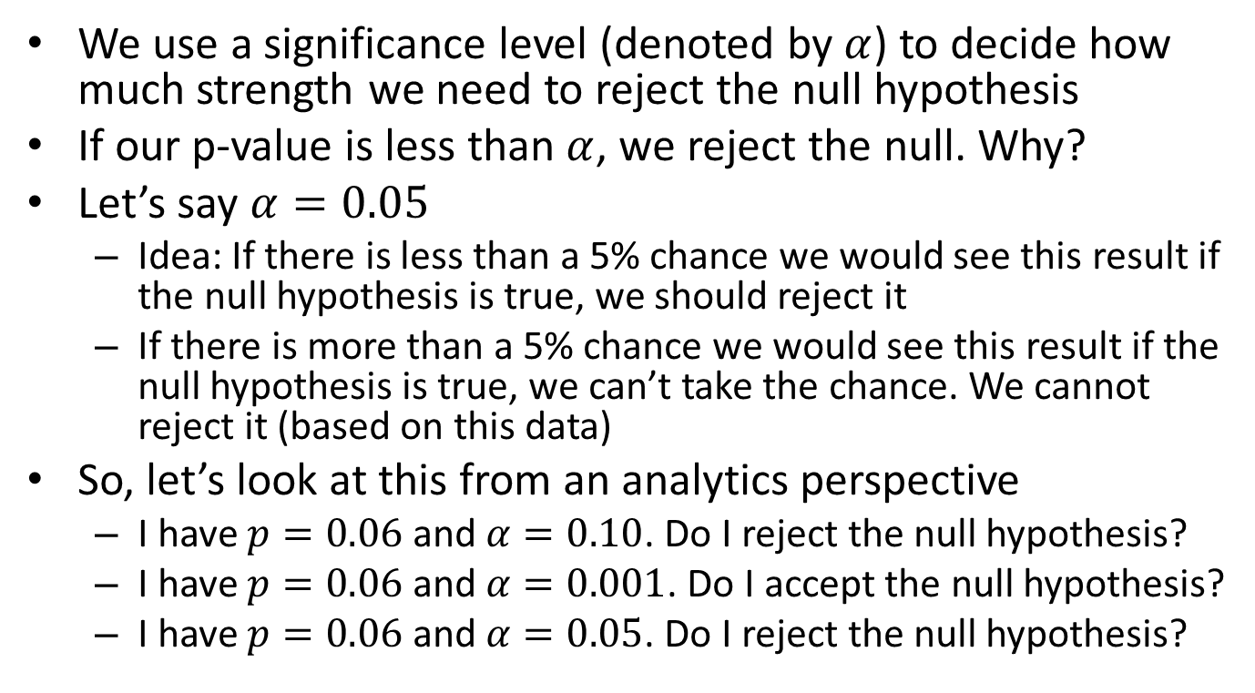
P-value Roundup
We use a significance level (denoted by $α$) to decide how much strength we need to reject the null hypothesis
If our p-value is less than $α$, we reject the null. Why?
Let’s say $α=0.05$
Idea: If there is less than a 5% chance we would see this result if the null hypothesis is true, we should reject it
If there is more than a 5% chance we would see this result if the null hypothesis is true, we can’t take the chance. We cannot reject it (based on this data)
So, let’s look at this from an analytics perspective
I have $p=0.06$ and $α=0.10$. Do I reject the null hypothesis?
I have $p=0.06$ and $α=0.001$. Do I accept the null hypothesis?
I have $p=0.06$ and $α=0.05$. Do I reject the null hypothesis?

Slide 9
Conditional Probability
P-values are an example of a conditional probability
That is, given this null hypothesis is true, our data gives us a probability of [p-value]
Our results are conditional on the null being true
A lot of the issues in media data reporting center around understanding conditional probability
Let’s say I have…
A 10% risk of contracting COVID
A 20% risk of dying from COVID if I contract it
What’s my overall risk of death from COVID?
This is a condition, so this is conditional probability!

Slide 10

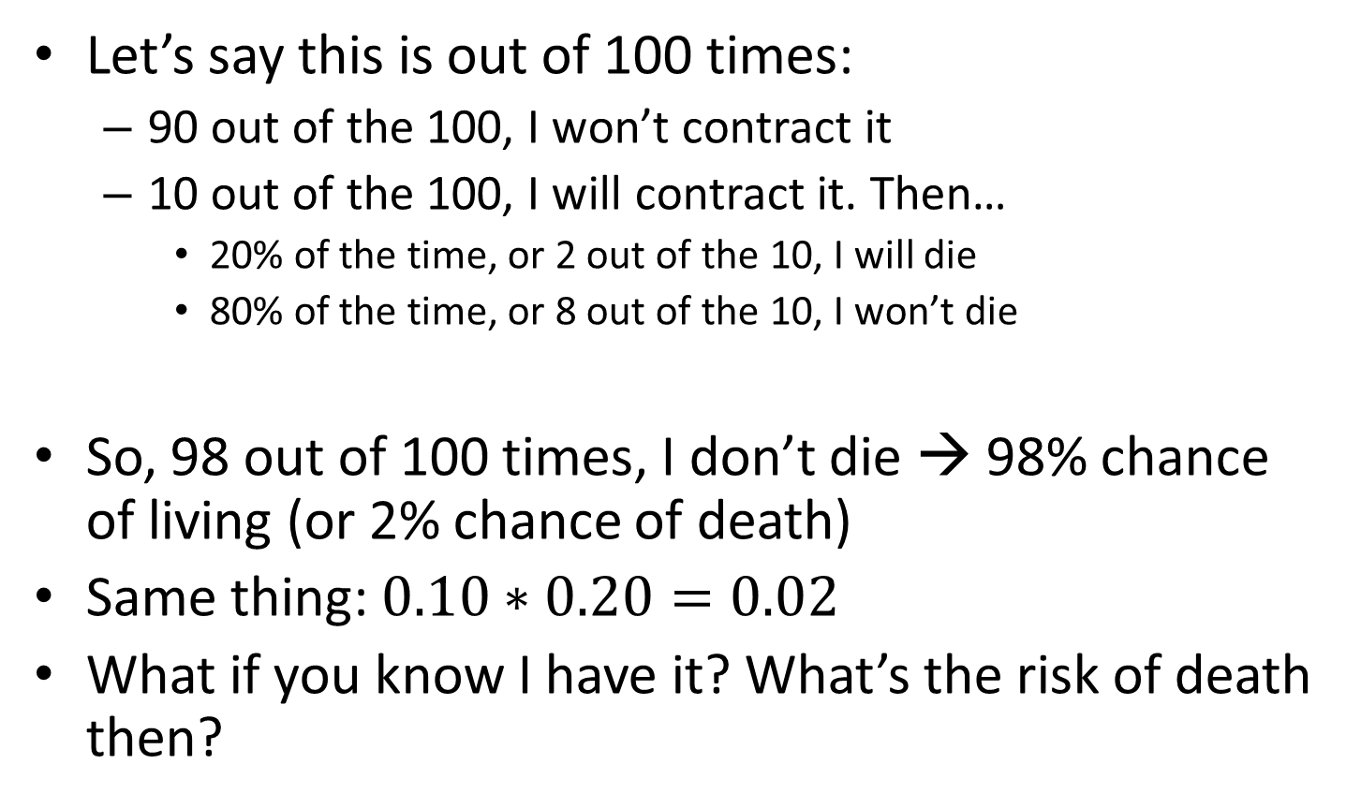
Conditional Probability
Let’s say this is out of 100 times:
90 out of the 100, I won’t contract it
10 out of the 100, I will contract it. Then…
20% of the time, or 2 out of the 10, I will die
80% of the time, or 8 out of the 10, I won’t die
So, 98 out of 100 times, I don’t die → 98% chance of living (or 2% chance of death)
Same thing: $0.10∗0.20=0.02$
What if you know I have it? What’s the risk of death then?
Image: A picture of a taco reading “yay taco”
Image: A picture of a taco reading “yay taco”

Slide 11
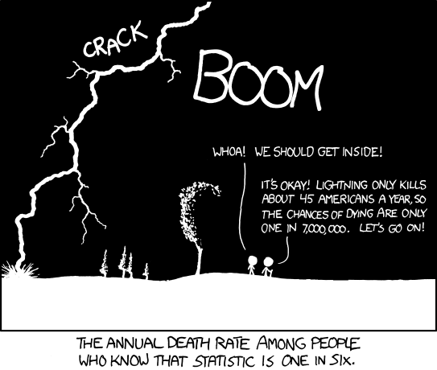
Conditional Probability
That’s conditional probability: once you know (or assume!) something about a system, it changes your analysis
Image description: Lightning and thunder boom as two stick figures walk. Figure 1 says, “Whoa! We should get inside.” Figure 2 says, “It’s okay! Lightning only kills about 45 Americans a year, so the chances of dying are only one in seven million. Let’s go on!” Figure caption says, “The annual death rate among people who know that statistics is one in six.”
Source: https://xkcd.com/795/

Slide 12
Conditional Probability
Consider the following table, which attempts to answer the age-old question: “Does pineapple belong on pizza?”
Region | Absolutely Not | Undecided | Yes | Total
West | 29 | 14 | 50 | 93
South | 9 | 3 | 11 | 23
Northeast | 7 | 3 | 11 | 21
Midwest | 5 | 0 | 0 | 5
Outside U.S. | 1 | 0 | 2 | 3
Total | 51 | 20 | 74 | 145
What is the probability a random person thinks pineapple belongs on pizza?

Slide 13
Conditional Probability
Consider the following table, which attempts to answer the age-old question: “Does pineapple belong on pizza?”
Region | Absolutely Not | Undecided | Yes | Total
West | 29 | 14 | 50 | 93
South | 9 | 3 | 11 | 23
Northeast | 7 | 3 | 11 | 21
Midwest | 5 | 0 | 0 | 5
Outside U.S. | 1 | 0 | 2 | 3
Total | 51 | 20 | 74 | 145
What is the probability a random person in the South thinks pineapple belongs on pizza?

Slide 14
Conditional Probability
Consider the following table, which attempts to answer the age-old question: “Does pineapple belong on pizza?”
Region | Absolutely Not | Undecided | Yes | Total
West | 29 | 14 | 50 | 93
South | 9 | 3 | 11 | 23
Northeast | 7 | 3 | 11 | 21
Midwest | 5 | 0 | 0 | 5
Outside U.S. | 1 | 0 | 2 | 3
Total | 51 | 20 | 74 | 145
What is the probability a random person who is undecided is from the West region?

Slide 15
Probability: It’s a Killer
Consider the following CDC table showing number of deaths broken down by common illness:
Age group | All Deaths involving COVID-19 | Deaths from All Causes | Deaths involving Pneumonia (no flu) | Deaths involving COVID-19 and Pneumonia (no flu) | All Deaths involving Influenza | Deaths involving Pneumonia, Influenza, or COVID-19 | Population
All ages | 175866 | 1894447 | 180095 | 78446 | 6671 | 283199 | 327167434
Under 1 year | 19 | 10513 | 99 | 3 | 16 | 131 | 3848208
1–4 years | 14 | 2021 | 70 | 2 | 42 | 124 | 15962067
5–14 years | 29 | 3110 | 94 | 8 | 52 | 167 | 41075169
15–24 years | 315 | 19998 | 402 | 111 | 53 | 655 | 42970800
25–34 years | 1360 | 41370 | 1513 | 606 | 151 | 2404 | 45697774
35–44 years | 3542 | 58523 | 3377 | 1547 | 247 | 5590 | 41277888
45–54 years | 9324 | 107903 | 8747 | 4292 | 577 | 14251 | 41631699
55–64 years | 22254 | 247264 | 23449 | 10694 | 1237 | 36026 | 42272636
65–74 years | 37684 | 374953 | 39742 | 17965 | 1444 | 60671 | 30492316
75–84 years | 46487 | 458477 | 49189 | 21421 | 1469 | 75520 | 15394374
85 years and over | 54838 | 570315 | 53413 | 21797 | 1383 | 87660 | 6544503
Notes:
Activity: Use this table to answer 4 questions!
Question 1: According to this table, what is the probability of a random person’s death involving COVID?
Question 2: According to this table, what is the probability of a random person’s death involving COVID given they are less than 35 years of age?
Question 3: According to this table, is a random person more likely to have died of COVID or of influenza?
Question 4: According to this table, what is the probability of a random person aged 15-24 years having died of COVID?

Slide 16
Concluding Remarks
This is a reminder about some of the big ideas of probability
Probability informs your decisions, but it doesn’t make them!
If there is a 1% chance…
Of missing class if you hit “snooze,” do you hit snooze?
Of failing class if you hit “snooze,” do you hit snooze?
Of failing to graduate if you hit “snooze,” do you hit snooze?
Of giving your grandmother COVID if you don’t wear a mask, do you wear a mask?
This is the logic underlying mask theory
Low odds of something happening does not mean the risk is worth it

Slide 17
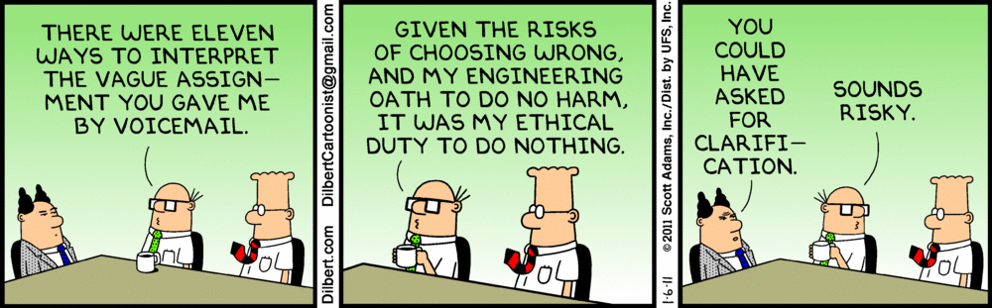
Concluding Remarks
This is especially important for business
If there’s a 1% chance your product is killing customers, do you recall the product?
This is the basis of risk analysis…which is just analytics!
First panel: Employee says to boss, “There were eleven ways to interpret the vague assignment you gave me by voicemail.”
Second panel: Employee says, “Given the risks of choosing wrong, and my engineering oath to do no harm, it was my ethical duty to do nothing.”
Last panel: Boss says, “You could have asked for clarification.” Employee responds, “Sounds risky.”

